Slide 1

Software Engineering & Project Management
Prof. Yashwant Dongre
Yashwant.dongre@viit.ac.in
Department of Computer Engineering
BRACT’S, Vishwakarma Institute of Information Technology, Pune-48
(An Autonomous Institute affiliated to Savitribai Phule Pune University)
(NBA and NAAC accredited, ISO 9001:2015 certified)

Slide 2
Last Session Recap
(Applicable for subsequent sessions)
1.
2.
3.
Prof. Yashwant Dongre, Department of Computer Engineering, VIIT, Pune-48

Slide 3
Objective/s of this session
1.
2.
3.
1.
2.
3.
Learning Outcome/Course Outcome
Prof. Yashwant Dongre, Department of Computer Engineering, VIIT, Pune-48

Slide 4
Contents
Agile software development
Agile methods
Plan-driven and agile development
Extreme programming Practices
Testing in XP
Pair programming.
Prof. Yashwant Dongre, Department of Computer Engineering, VIIT, Pune-48

Slide 5
Agile methods
Dissatisfaction with the overheads involved in design methods led to the creation of agile methods. These methods:
  Focus on the code rather than the design;
  Are based on an iterative approach to software development;
  Are intended to deliver working software quickly and evolve this quickly to meet changing requirements.
Agile methods are probably best suited to small/medium-sized business systems or PC products.
Prof. Yashwant Dongre, Department of Computer Engineering, VIIT, Pune-48

Slide 6
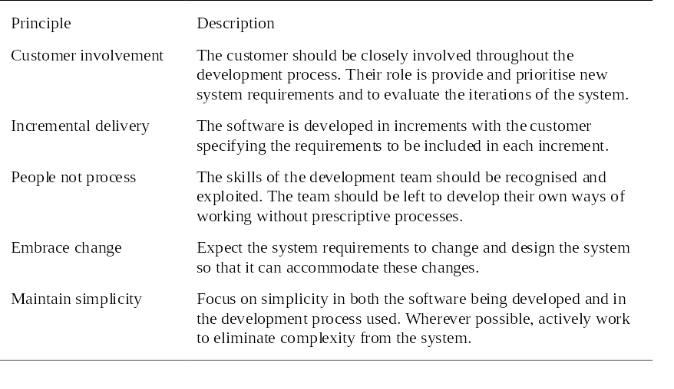
Principles of agile methods
Prof. Yashwant Dongre, Department of Computer Engineering, VIIT, Pune-48

Slide 7
Problems with agile methods
It can be difficult to keep the interest of customers who are involved in the process.
Team members may be unsuited to the intense involvement that characterizes agile methods.
Prioritizing changes can be difficult where there are multiple stakeholders.
Maintaining simplicity requires extra work.
Contracts may be a problem as with other approaches to iterative development.
Prof. Yashwant Dongre, Department of Computer Engineering, VIIT, Pune-48

Slide 8
Extreme programming
Perhaps the best-known and most widely used agile method.
Extreme Programming (XP) takes an ‘extreme’ approach to iterative development.
  New versions may be built several times per day;
  Increments are delivered to customers every 2 weeks;
  All tests must be run for every build and the build is only accepted if tests run successfully.
Prof. Yashwant Dongre, Department of Computer Engineering, VIIT, Pune-48

Slide 9
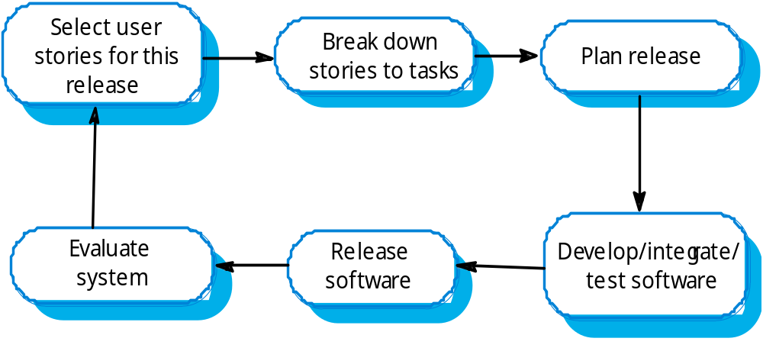
The XP release cycle
Prof. Yashwant Dongre, Department of Computer Engineering, VIIT, Pune-48

Slide 10
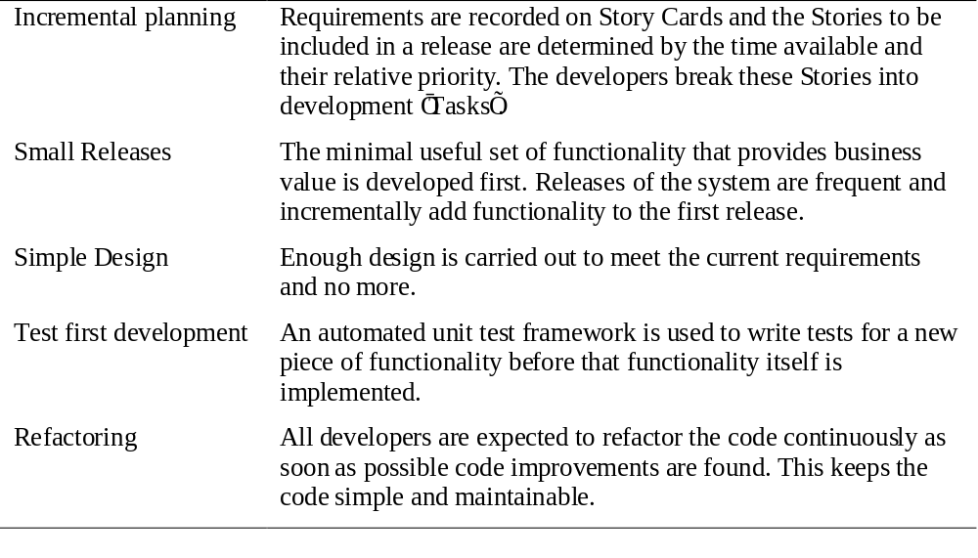
Extreme programming practices 1
Prof. Yashwant Dongre, Department of Computer Engineering, VIIT, Pune-48

Slide 11
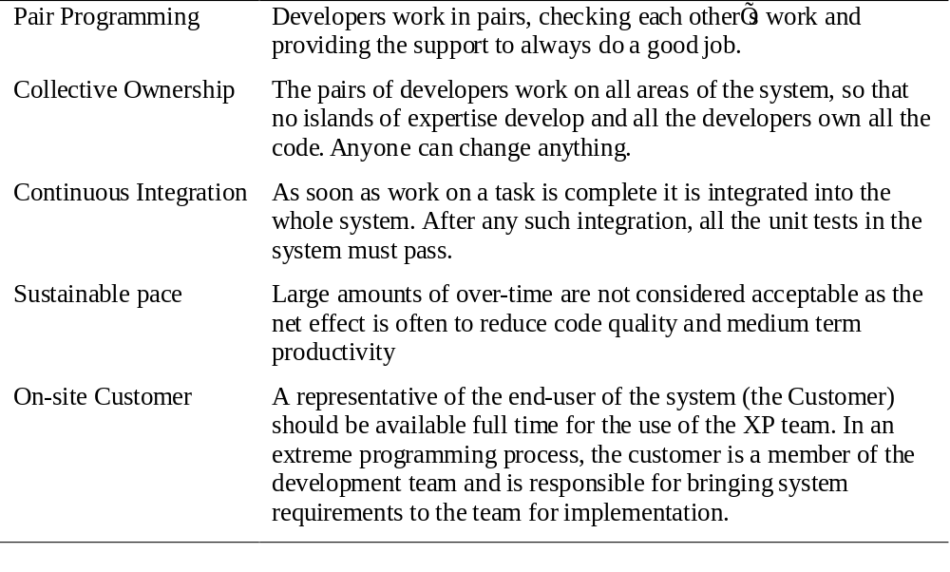
Extreme programming practices 2
Prof. Yashwant Dongre, Department of Computer Engineering, VIIT, Pune-48

Slide 12
XP and agile principles
Incremental development is supported through small, frequent system releases.
Customer involvement means full-time customer engagement with the team.
People not process through pair programming, collective ownership and a process that avoids long working hours.
Change supported through regular system releases.
Maintaining simplicity through constant refactoring of code.
Prof. Yashwant Dongre, Department of Computer Engineering, VIIT, Pune-48

Slide 13
Requirements scenarios
In XP, user requirements are expressed as scenarios or user stories.
These are written on cards and the development team break them down into implementation tasks. These tasks are the basis of schedule and cost estimates.
The customer chooses the stories for inclusion in the next release based on their priorities and the schedule estimates.
Prof. Yashwant Dongre, Department of Computer Engineering, VIIT, Pune-48

Slide 14
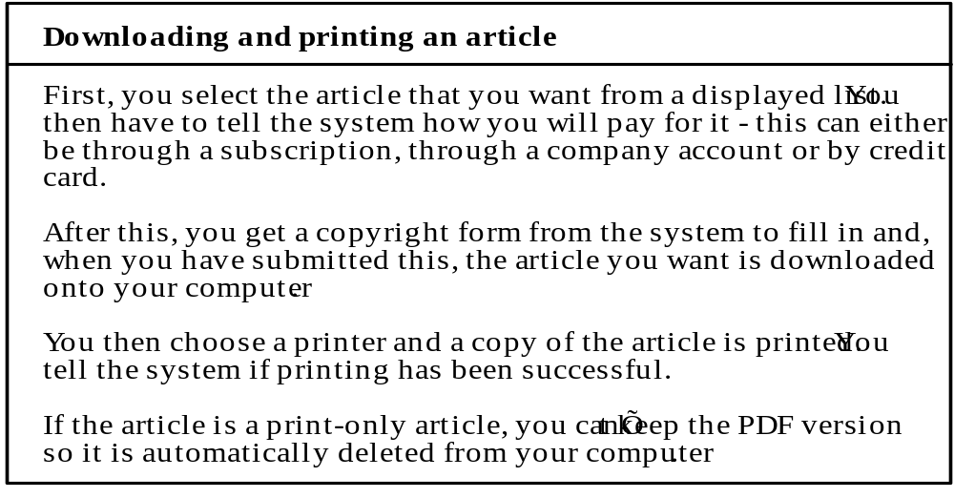
Story card for document downloading
Prof. Yashwant Dongre, Department of Computer Engineering, VIIT, Pune-48

Slide 15
XP and change
Conventional wisdom in software engineering is to design for change. It is worth spending time and effort anticipating changes as this reduces costs later in the life cycle.
XP, however, maintains that this is not worthwhile as changes cannot be reliably anticipated.
Rather, it proposes constant code improvement (refactoring) to make changes easier when they have to be implemented.
Prof. Yashwant Dongre, Department of Computer Engineering, VIIT, Pune-48

Slide 16
Testing in XP
Test-first development.
Incremental test development from scenarios.
User involvement in test development and validation.
Automated test harnesses are used to run all component tests each time that a new release is built.
Prof. Yashwant Dongre, Department of Computer Engineering, VIIT, Pune-48

Slide 17
Pair programming
In XP, programmers work in pairs, sitting together to develop code.
This helps develop common ownership of code and spreads knowledge across the team.
It serves as an informal review process as each line of code is looked at by more than 1 person.
It encourages refactoring as the whole team can benefit from this.
Measurements suggest that development productivity with pair programming is similar to that of two people working independently
Prof. Yashwant Dongre, Department of Computer Engineering, VIIT, Pune-48

Slide 18
Instructions/Guidelines/References
1.
2.
3.
4.
Prof. Yashwant Dongre, Department of Computer Engineering, VIIT, Pune-48

Slide 19
Wrap up and related outcomes
1.
2.
3.
4.
Prof. Yashwant Dongre, Department of Computer Engineering, VIIT, Pune-48

Slide 20
To be discussed next time
Part –I
Engineering as a Profession.. How does it different from other profession?
Roles and responsibilities of engineers
Significance of ethics in engineering
Part-II
Code of Ethical conduct for an engineer
Ethics, Law and Moral form engineers perspective
Case studies/examples of ethical reasoning …closely related to business ethics
Part-III
E-mail Etiquettes
Telephone Etiquettes
Social Etiquettes
Prof. Yashwant Dongre, Department of Computer Engineering, VIIT, Pune-48

Slide 21
Thank You
Prof. Yashwant Dongre, Department of Computer Engineering, VIIT, Pune-48

